Slide 1
PERSONAL FITNESS LESSON #6
COMMON INJURIES AND ILLNESSES FROM TRAINING

Slide 2
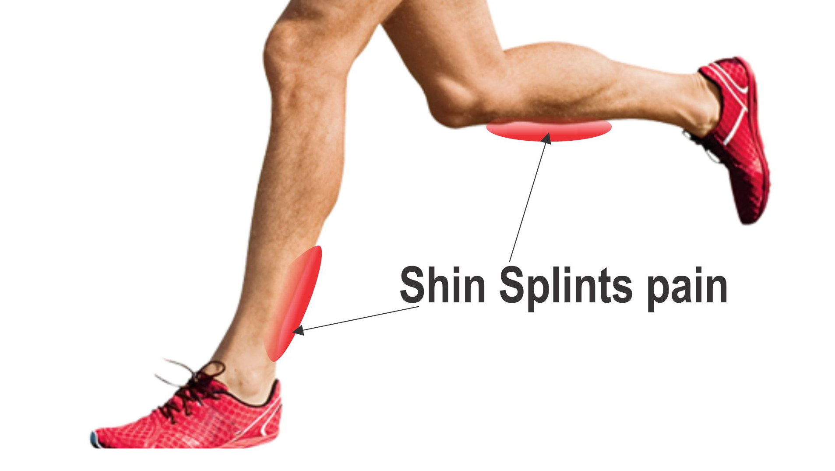
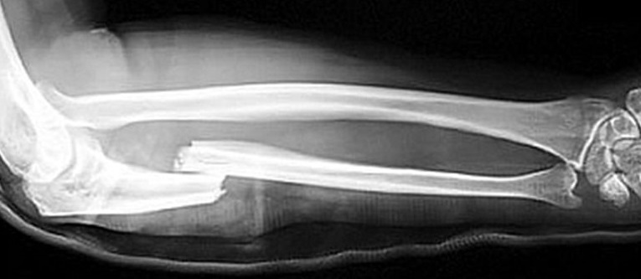
INJURIES
CHRONIC INJURIES
ACUTE INJURIES
An injury that results from overuse or training
Examples:
Shin splints and stress fractures
Result from an accident that occurs while participating in an activity or just by coincidence
Examples:
Ankle sprain, muscle strain and breaking a bone

Slide 3
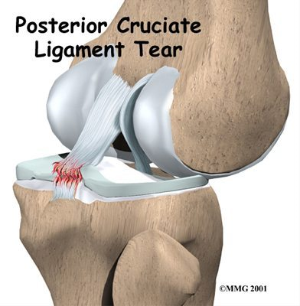
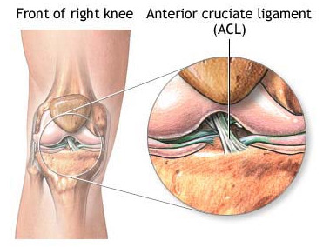
Ligaments
Tissues that connect the bone together
Common ligaments that get injured
Anterior Cruciate Ligament- middle of the knee. It prevents the shin bone from sliding out in front of the thigh bone
Posterior Cruciate Ligament-back of the knee. It is one of several ligaments that connect the thighbone to the shinbone

Slide 4
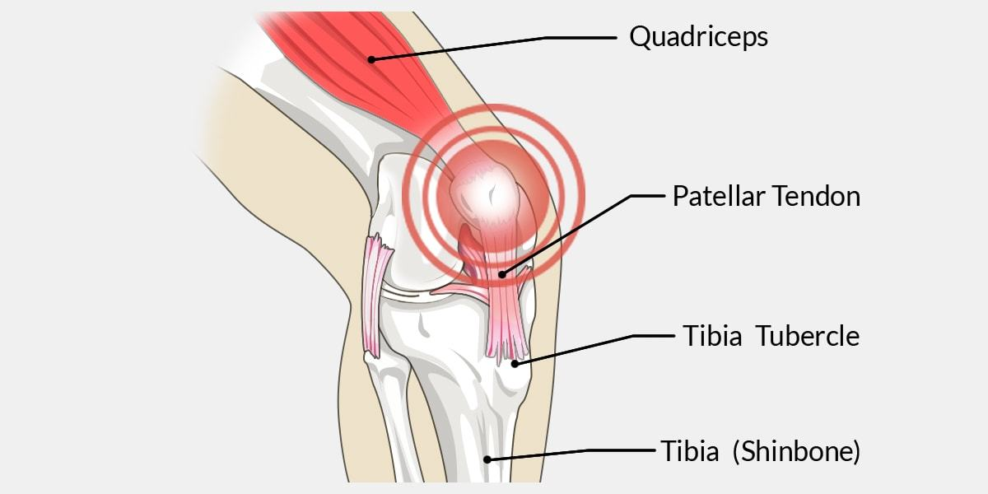
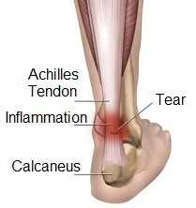
TENDONS
Tissues that connect muscles to bone
Common tendons which get injured:
Patellar tendon- connects knee cap to shin bone
Achilles tendon- connects the calf muscle to the heel

Slide 5
TENDINITIS
Inflammation or irritation of a tendon.
It can occur ANYWHERE; but most common in the shoulder, elbow, wrist, hip, knee, foot or ankle.

Slide 6
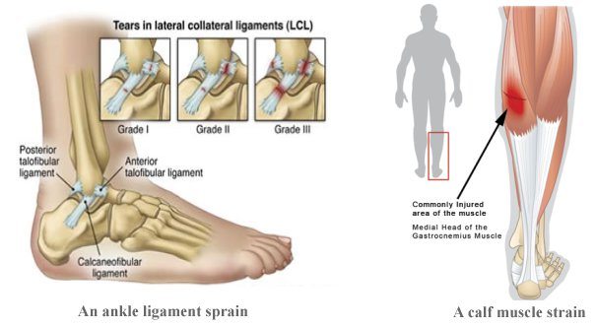
SPRAINS
A stretching or tearing of ligaments, the fibrous tissue that connects bones and joints.

Slide 7
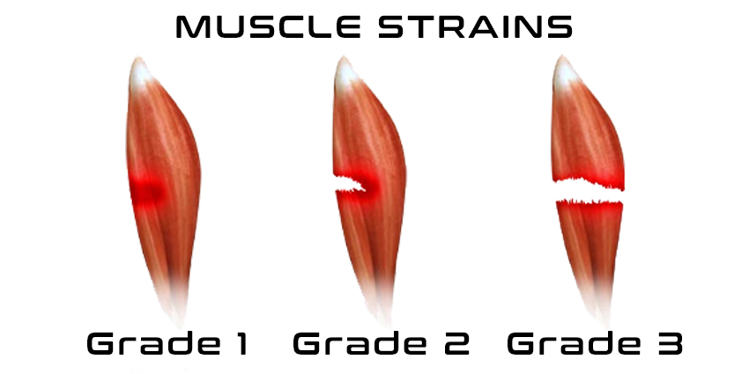
STRAINS
A stretching or tearing of muscle or a tissue connecting muscle to bone

Slide 8
Treatment of Injuries RICE is a mnemonic for four elements of treatment for soft tissue injuries – an acronym for Rest, Ice, Compression and Elevation.

Slide 9
Signs vs. Symptoms of Injuries
SIGNS
Don’t ignore these…
Bruising
Swelling
Bleeding
Tenderness
Weakness
SYMPTOMS
These will feel different than the signs…
Pain
Soreness

Slide 10
Injury Prevention
Warm-up and cool down (a must before and after a workout)
Listen to your body… pain = STOP!!
Wear good shoes for the training that you are doing (look at the shoes and what they are actually made for)
Wear the appropriate clothing for training→ what do you think I mean by this?
Hydrate.. Appropriately!!
Eat properly for your training
Know your limits→ if you don’t you won’t be able to keep up with your training
Go to a doctor if you are in pain and it doesn’t get any better!

Slide 11
What is muscle balance and why it is so important?
It will help reduce the chance of injuries!
Having an equal amount of muscle on each side of a joint is important to avoid the chance of an injury

Slide 12
Heat Illness and Training
HEAT CRAMPS→ muscle spasms that result from loss of large amount of salt and water through exercise. Heat cramps are associated with cramping in the abdomen, arms and calves. This can be caused by inadequate consumption of fluids or electrolytes.
HEAT EXHAUSTION→ a condition whose symptoms may include heavy sweating and a rapid pulse, a result of your body overheating. It's one of three heat-related syndromes, with heat cramps being the mildest and heatstroke being the most severe & it is preventable
HEAT STROKE→ a condition marked by fever and often by unconsciousness, caused by failure of the body's temperature-regulating mechanism when exposed to excessively high temperatures.

Slide 13
What you should do with each heat illness
Heat Cramps: Hard tense muscles… cramps that begin suddenly in the hands, calves or feet
- What to do → Move to a cooler or area with AC and sip water slowly

Slide 14
Preventing Heat Stroke
Wear loosefitting, lightweight clothing. Wearing excess clothing or clothing that fits tightly won't allow your body to cool properly.
Protect against sunburn. Sunburn affects your body's ability to cool itself, so protect yourself outdoors with a wide-brimmed hat and sunglasses and use a broad-spectrum sunscreen with an SPF of at least 15. Apply sunscreen generously, and reapply every two hours — or more often if you're swimming or sweating.
Drink plenty of fluids. Staying hydrated will help your body sweat and maintain a normal body temperature.
Take extra precautions with certain medications. Be on the lookout for heat-related problems if you take medications that can affect your body's ability to stay hydrated and dissipate heat.
Never leave anyone in a parked car. This is a common cause of heat-related deaths in children. When parked in the sun, the temperature in your car can rise 20 degrees F (more than 6.7 C) in 10 minutes.
Take it easy during the hottest parts of the day. If you can't avoid strenuous activity in hot weather, drink fluids and rest frequently in a cool spot. Try to schedule exercise or physical labor for cooler parts of the day, such as early morning or evening.
Get acclimated. Limit time spent working or exercising in heat until you're conditioned to it. People who are not used to hot weather are especially susceptible to heat-related illness. It can take several weeks for your body to adjust to hot weather.
Be cautious if you're at increased risk. If you take medications or have a condition that increases your risk of heat-related problems, avoid the heat and act quickly if you notice symptoms of overheating. If you participate in a strenuous sporting event or activity in hot weather, make sure there are medical services available in case of a heat emergency.

Slide 15
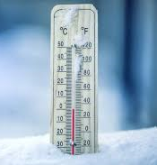
Cold Weather Illnesses while Training
FROSBITE→ A condition in which skin and the tissue just below the skin freeze.
Sensory: pins and needles, reduced sensation of touch, skin burning sensation, or stinging sensation
Skin: blue skin from poor circulation or redness
Also common: blistering, feeling cold, or waxy skin
HYPOTHERMIA→ the condition of having an abnormally low body temperature, typically one that is dangerously low.
First stage: shivering, reduced circulation;
Second stage: slow, weak pulse, slowed breathing, lack of co-ordination, irritability, confusion and sleepy behavior;
Advanced stage: slow, weak or absent respiration and pulse.

Slide 16
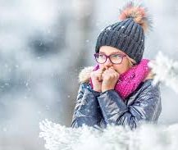
Preventing Hypothermia
Staying warm in cold weather. Before step out into cold air, remember the advice that follows with the simple acronym COLD —
Cover
Overexertion
Layers
Dry
Cover. Wear a hat or other protective covering to prevent body heat from escaping from your head, face and neck

Slide 17
CONCLUSION
What got your attention the most??

